Slide 1
Deep Fusion LSTMs for Text Semantic Matching
Pengfei Liu, Xipeng Qiu∗, Jifan Chen, Xuanjing Huang
By GuoTongLei

Slide 2
Outline
PPT模板下载：www.1ppt.com/moban/ 行业PPT模板：www.1ppt.com/hangye/
节日PPT模板：www.1ppt.com/jieri/ PPT素材下载：www.1ppt.com/sucai/
PPT背景图片：www.1ppt.com/beijing/ PPT图表下载：www.1ppt.com/tubiao/
优秀PPT下载：www.1ppt.com/xiazai/ PPT教程： www.1ppt.com/powerpoint/
Word教程： www.1ppt.com/word/ Excel教程：www.1ppt.com/excel/
资料下载：www.1ppt.com/ziliao/ PPT课件下载：www.1ppt.com/kejian/
范文下载：www.1ppt.com/fanwen/ 试卷下载：www.1ppt.com/shiti/
教案下载：www.1ppt.com/jiaoan/ PPT论坛：www.1ppt.cn
01
Introduction
02
Models
目录
CONTENTS
03
04
Dataset
Experiments

Slide 3
Introduction
^{Text semantic matching:}
^{Classification}
el interactions有些懈怠，事情比较多比较杂，搅在一起让人丧失了动力
modelling the relevance/similarity of a pair of texts
^{Weak Interaction Models}
^{sentence level interactions}
^{Semi} ^{Interaction Models}
^{use soft attention mechanism}
^{Strong} ^{Interaction Models}
build the interaction at different granularity

Slide 4
Introduction
最^{contribution}
Model the strong interactions of two texts in a recursive matching way.
Perform extensive empirical studies on two very large datasets.
Present an elaborate qualitative analysis of our model.

Slide 5
Outline
PPT模板下载：www.1ppt.com/moban/ 行业PPT模板：www.1ppt.com/hangye/
节日PPT模板：www.1ppt.com/jieri/ PPT素材下载：www.1ppt.com/sucai/
PPT背景图片：www.1ppt.com/beijing/ PPT图表下载：www.1ppt.com/tubiao/
优秀PPT下载：www.1ppt.com/xiazai/ PPT教程： www.1ppt.com/powerpoint/
Word教程： www.1ppt.com/word/ Excel教程：www.1ppt.com/excel/
资料下载：www.1ppt.com/ziliao/ PPT课件下载：www.1ppt.com/kejian/
范文下载：www.1ppt.com/fanwen/ 试卷下载：www.1ppt.com/shiti/
教案下载：www.1ppt.com/jiaoan/ PPT论坛：www.1ppt.cn
01
Introduction
02
Models
目录
CONTENTS
03
04
Dataset
Experiments

Slide 6
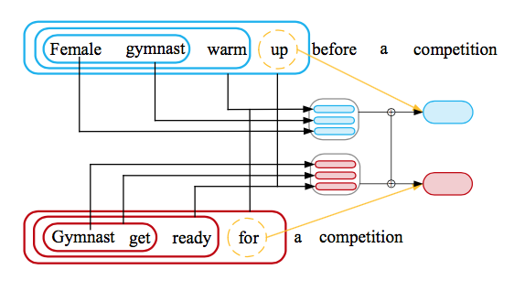

Models
Recursively Text Semantic Matching
^{Input} ^{sequences:} ^{X = x}₁^{,x}₂^{,··· ,x}_{m} ; ^{Y = y}₁^{,y}₂^{,··· ,y}_{n}
^{Matching vector h(X, Y)}
weak interaction : h(X,Y) = f(h(X),h(Y))
f (·) : concatenation/affine transformation/bilinear…(or ^{combination)}
^{strong interaction :}
^{⊕ : concatenation operation}
^{(h}_{4,4} ^{) = (h}_{1,4}^{, · · · , h}_{3,4}^{, h}_{4,1}^{, · · · , h}_{4,3}⁾

Slide 7
Models
Recursively Text Semantic Matching
^{Input} ^{sequences:} ^{X = x}₁^{,x}₂^{,··· ,x}_{m} ; ^{Y = y}₁^{,y}₂^{,··· ,y}_{n}
^{Matching vector h(X, Y)}
weak interaction : h(X,Y) = f(h(X),h(Y))
f (·) : concatenation/affine transformation/bilinear…(or ^{combination)}
^{strong interaction :}
^{⊕ : concatenation operation}
^{(h}_{4,4} ^{) = (h}_{1,4}^{, · · · , h}_{3,4}^{, h}_{4,1}^{, · · · , h}_{4,3}⁾

Slide 8
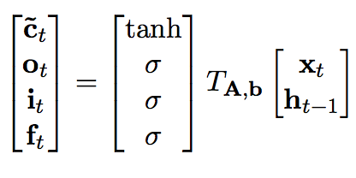
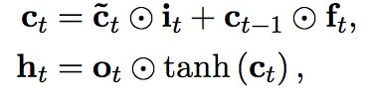
Models
^{Long Short-Term Memory Network}
^{input gate i}_{t} ^{forget gate f}_{t} ^{output gate o}_{t}
^{memory cell c}_{t} ^{hidden state h}_{t}
LSTM can map the input sequence of arbitrary length to a fixed-sized vector

Slide 9
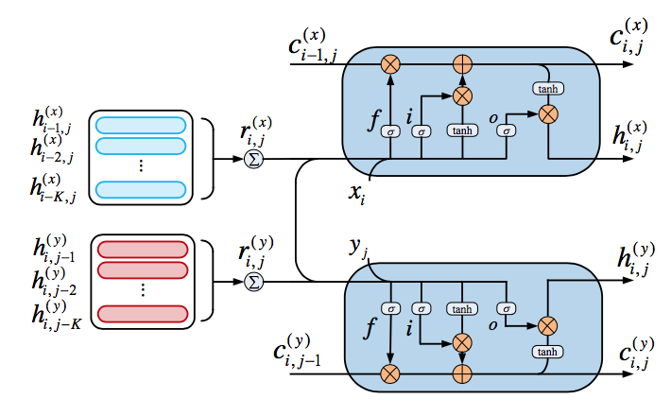

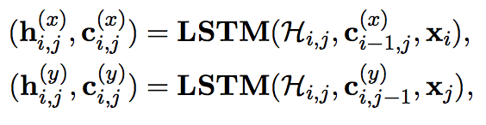

Models
Deep Fusion LSTMs for Recursively Semantic Matching
At position i of sentence x_{1:n} , the output h_{i} reflects the meaning of subsequence x_{1:i} = x₁ ,··· ,x_{i}
the interaction of the subsequences x_{1:i} and y_{1:j} :

Slide 10

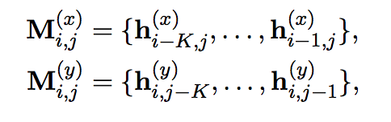
Models
Deep Fusion LSTMs for Recursively Semantic Matching
^{Problem:}
There are total m×n interactions, LSTM could be stressed to keep these interactions in internal memory.
^{Solution:}
Introduce two external memories to keep the history information.
K : the number of memory segments d : the size of each segment

Slide 11
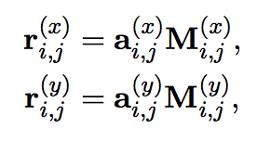
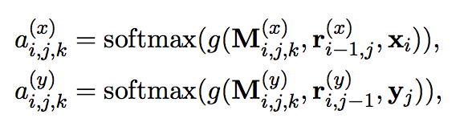


Models
Deep Fusion LSTMs for Recursively Semantic Matching
read vector from external memories : ri,j
^{M}i,j,k represents the k-th row memory vector at position (i,j)
^{v is a parameter vector and W}a ^{is a parameter matrix}
^{The history information}

Slide 12
Outline
PPT模板下载：www.1ppt.com/moban/ 行业PPT模板：www.1ppt.com/hangye/
节日PPT模板：www.1ppt.com/jieri/ PPT素材下载：www.1ppt.com/sucai/
PPT背景图片：www.1ppt.com/beijing/ PPT图表下载：www.1ppt.com/tubiao/
优秀PPT下载：www.1ppt.com/xiazai/ PPT教程： www.1ppt.com/powerpoint/
Word教程： www.1ppt.com/word/ Excel教程：www.1ppt.com/excel/
资料下载：www.1ppt.com/ziliao/ PPT课件下载：www.1ppt.com/kejian/
范文下载：www.1ppt.com/fanwen/ 试卷下载：www.1ppt.com/shiti/
教案下载：www.1ppt.com/jiaoan/ PPT论坛：www.1ppt.cn
01
Introduction
02
Models
目录
CONTENTS
03
04
Training
Experiments

Slide 13
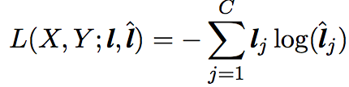
Training
Task Specific Output & Loss Function
^{ranking task}
output - a scalar matching score(linear transformation)
^{Max-Margin Loss :}
^{classification task}
outputs - the probabilities of the different classes(softmax function)
^{Cross-entropy Loss :}

Slide 14
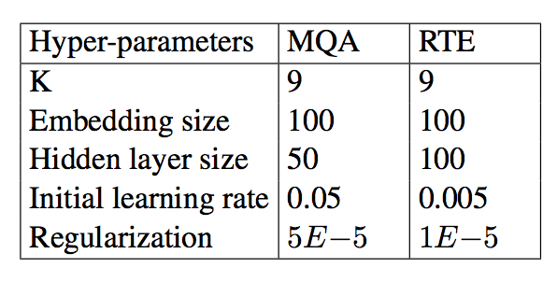
Training
^{Optimizer}
^{AdaGrad SGD}
^{Initialization}
Orthogonal Initialization (LSTMS)
100d GloVe vectors, randomly sampling from uniform distribution in [−0.1, 0.1]
^{Hyperparameters}

Slide 15
Outline
PPT模板下载：www.1ppt.com/moban/ 行业PPT模板：www.1ppt.com/hangye/
节日PPT模板：www.1ppt.com/jieri/ PPT素材下载：www.1ppt.com/sucai/
PPT背景图片：www.1ppt.com/beijing/ PPT图表下载：www.1ppt.com/tubiao/
优秀PPT下载：www.1ppt.com/xiazai/ PPT教程： www.1ppt.com/powerpoint/
Word教程： www.1ppt.com/word/ Excel教程：www.1ppt.com/excel/
资料下载：www.1ppt.com/ziliao/ PPT课件下载：www.1ppt.com/kejian/
范文下载：www.1ppt.com/fanwen/ 试卷下载：www.1ppt.com/shiti/
教案下载：www.1ppt.com/jiaoan/ PPT论坛：www.1ppt.cn
01
Introduction
02
Models
目录
CONTENTS
03
04
Dataset
Experiments

Slide 16
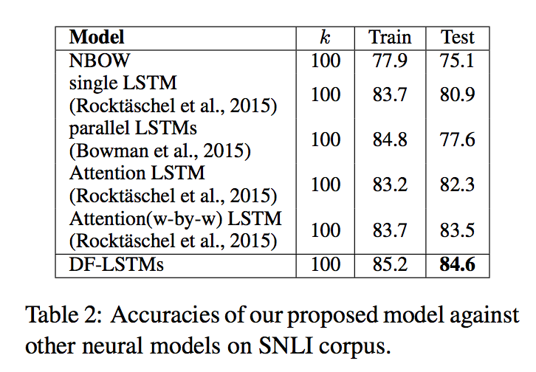
Experiments
Experiment-I: Recognizing Textual Entailment
determine the semantic relationship between two sentences

Slide 17
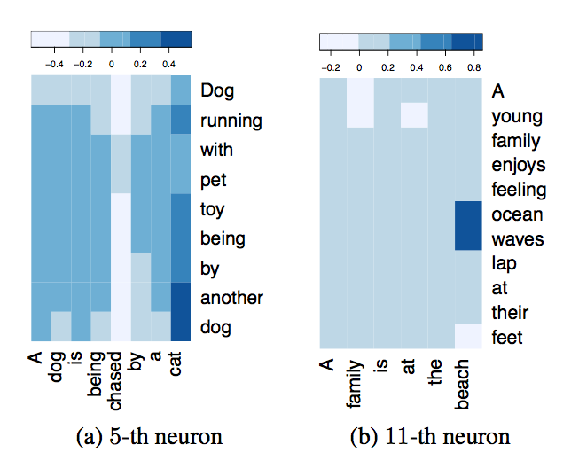
Experiments
A neuron shows its ability to monitor the word pairs with the property of describing different things of the same type.
Another neuron shows that it can capture the local contextual interactions.

Slide 18
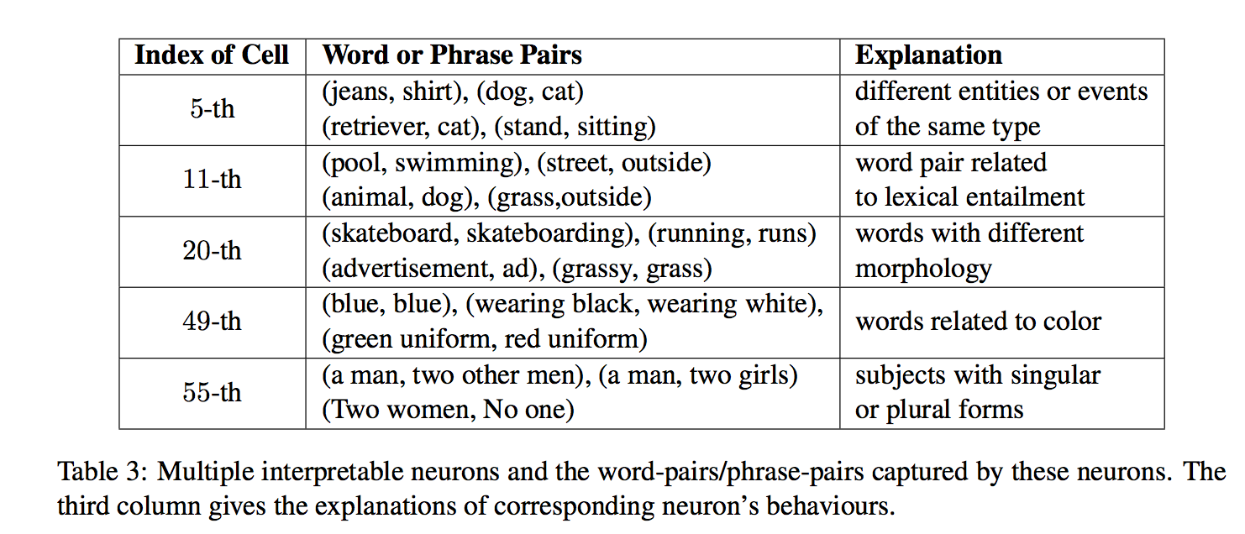
Experiments

Slide 19
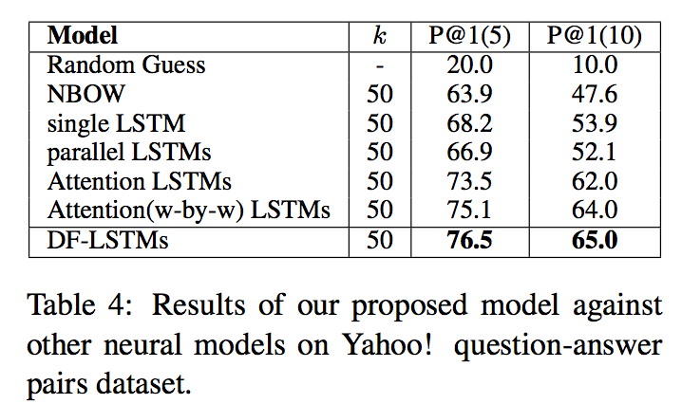
Experiments
Experiment-II: Matching Question and Answer
Given a question, select a correct answer from some candidate answers.

Slide 20
THANKS

